Slide 1
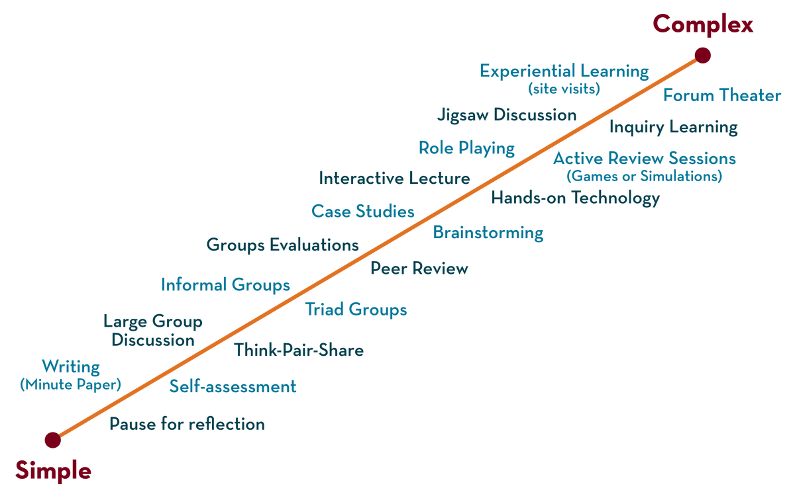
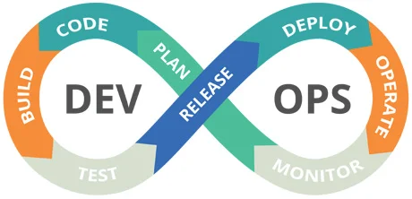

23sdcs13A/R
CI/CD and Cloud devops
Topic:
Git operations
Dr. suneetha Bulla

Slide 2
Git Basic Commands
push
Branch
Merge
Pull
Clone

Slide 3
Git Push
Step1: Create a React Project in the Local directory (React Project)
Step2: Create a Repository on GitHub (use same name local directory and remote git repository)
Step3: Redirect Project Directory in the command prompt/vscode
Step 4: use basic push commands

Slide 4
Git Push basic commands
git init # Initialize a Git repository
git add . # Stage all files
git commit -m "Initial commit" # Commit the staged files
git branch -M main # minimum one branch needed
git remote add origin repourl (repourl=https://github.com/your/username/FirstProject.git)
git push -u origin main

Slide 5
Git Branch
git branch is a command used to create, list, rename, or delete branches in Git.
Branches are used to isolate development work without affecting the main codebase.
git branch Lists all local branches
git branch <branch-name> Creates a new branch
git checkout <branch-name> Switches to the specified branch
git checkout -b <branch-name> Creates and switches to the new branch
git branch -d <branch-name> Deletes a local branch (if merged)
git branch -D <branch-name> Force deletes a branch
git branch -m <new-name> Renames the current branch

Slide 6
Git Merge
git checkout main
git pull origin main
git merge feature/login
git add
git commit
git push origin main
git merge is a Git command used to combine changes from one branch into another.
It is commonly used to integrate a feature branch into the main branch after development is complete.
Check Your Branches: git branch
main
feature/login
Switch to the Branch You Want to Merge Into : git checkout main
Merge the Feature Branch: git merge feature/login (Merge branch 'feature/login' into main)

Slide 7
Git Clone
Download code to your local machine for editing, testing, or building.
Start collaborating with others on a project.
Fork and clone public repositories to contribute via pull requests.
Fork : It is a copy of someone else’s repository on your GitHub account.
Clone: It is a copy of someone else’s repository on your Local Directory.
git clone https://github.com/username/repository-name.git my-folder

Slide 8
Set up a Git repo with separate branches for frontend and backend and merge into main.

Slide 9
Set up a Git repo with separate branches for frontend and backend and merge into main
Step1: Create a remote repository on GitHub and name it FullstackProject
Step2: Initialize Git in your fullstack project folder
Step3: Create Frontend Branch and Push frontend code
Step4: Create Backend Branch and Push backend code
Step5: Create Mian branch merge frontend and backend into main
Step6: Clone project into new directory

Slide 10
Git Actions

